Slide 1

IMDb
Datasets Analysis
Bruno Vaz, Fátima Barros, Maria João Lavoura
Professor: Álvaro Figueira | Data Visualization
January 8, 2021

Slide 2
IMDb Datasets
Internet Movie Database
People rely on other’s ratings for choosing their next movie or show
Title Akas
Titles translations and regions
Title Basics
Titles categories, genres, year, runtime
Title Crew
Directors and Writers
Title Principals
Job of people in the title
Name Basics
Professions and titles people are known for

Slide 3
Filtering
Title Basics
short
movie
tvMovie
tvSeries
tvShort
tvMiniSeries
tvEpisode
tvSpecial
Video
videoGame
Title Basics
1 443 759
Title Akas
Title Ratings
7 281 233
Filter by tconst…
Title Crew
Title Principals
Filter by nconst…
Name Basics

Slide 4
Filtering
Cleaning
Title Basics
Title Principals
Title Basics
short
movie
tvMovie
tvSeries
tvShort
tvMiniSeries
tvEpisode
tvSpecial
Video
videoGame
Title Basics
1 443 759
↓11%
4 621 598
=
1 443 759
1 277 962
4 621 598
Title Crew
Title Akas
Title Akas
Title Ratings
1 443 759
↓8%
2 211 001
↓14%
7 281 233
Filter by tconst…
1 330 669
1 911 339
Title Crew
Title Ratings
Name Basics
Title Principals
423 183
=
1 634 635
↓6%
Filter by nconst…
Name Basics
423 183
1 532 134

Slide 5
Filtering
Cleaning
Title Basics
Title Principals
Title Basics
short
movie
tvMovie
tvSeries
tvShort
tvMiniSeries
tvEpisode
tvSpecial
Video
videoGame
Title Basics
1 443 759
↓11%
4 621 598
=
1 443 759
1 277 962
4 621 598
Merge with Title Basics
Title Crew
Title Akas
Title Akas
Title Ratings
1 443 759
↓8%
2 211 001
↓14%
7 281 233
Filter by tconst…
1 330 669
1 911 339
Title Crew
Title Ratings
Name Basics
Title Principals
423 183
=
1 634 635
↓6%
Filter by nconst…
Name Basics
423 183
1 532 134

Slide 6




Proposed Hypotheses
Titles per Region
Titles’ Success
Cast and Crew Influence
Awards
“Is the title’s success influenced by the number of translations?”
“Does the cast/crew of a movie make it successful?”

Slide 7
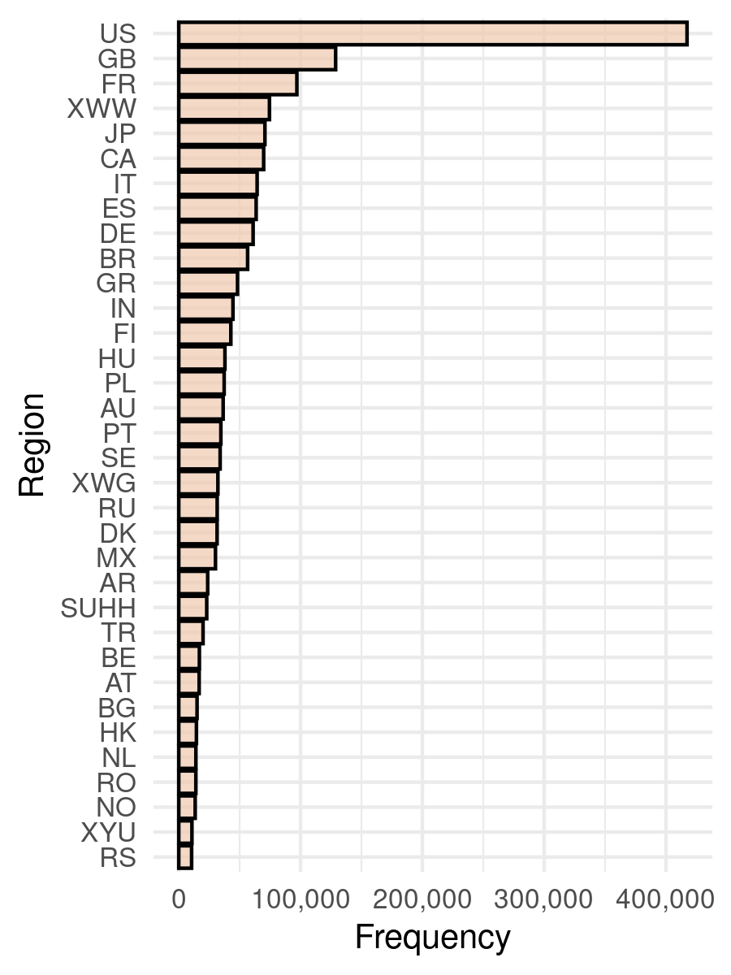
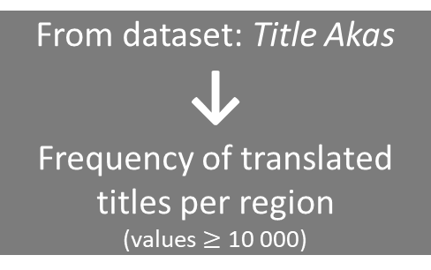
Titles per Region
From dataset: Title Akas
↓
Frequency of translated titles per region
(values $≥$ 10 000)

Slide 8
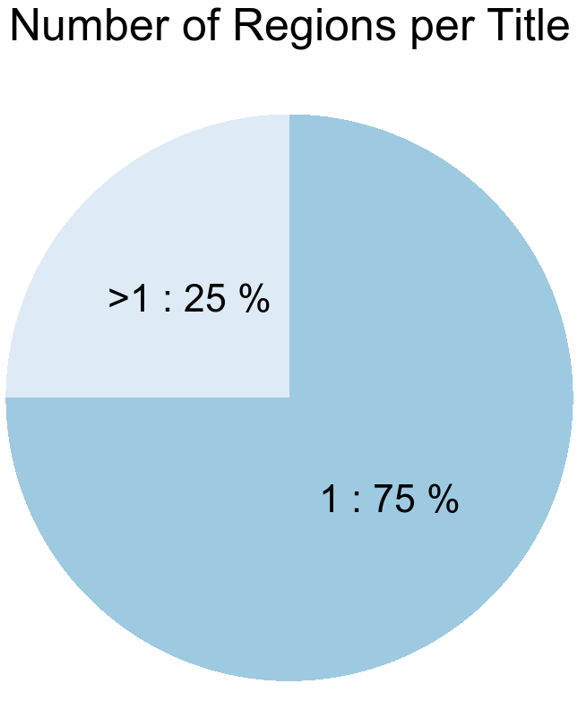
Titles per Region
From dataset: Title Akas
↓
Counts or regions per title
From dataset: Title Akas
↓
Frequency of translated titles per region
(values $≥$ 10 000)

Slide 9
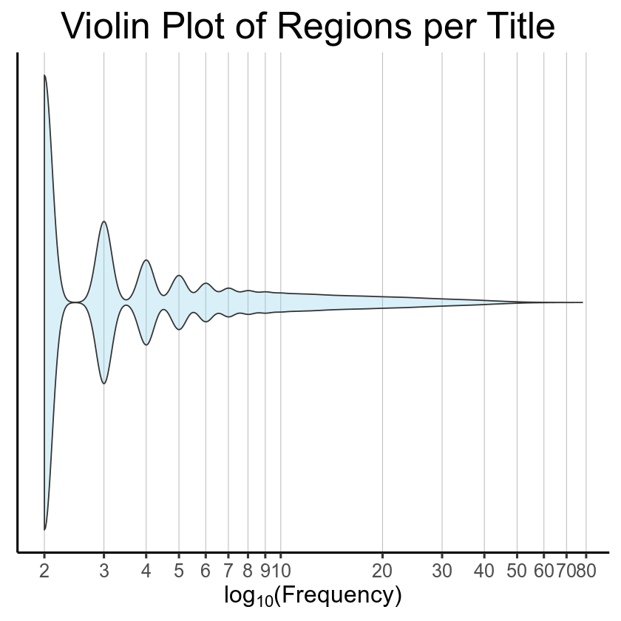
Titles per Region
From dataset: Title Akas
↓
Counts or regions per title
From dataset: Title Akas
↓
Frequency of translated titles per region
(values $≥$ 10 000)

Slide 10
Titles per Region
Using an extra dataset...
Countries
country_code
latitude
longitude
country
usa_state_code
usa_state_longitude
usa_state_latitude
usa_state

Slide 11
Titles per Region
Title Akas
↓8%
Title Akas Clean
Regions Frequency
Removal of
non-country regions
Transform
Using an extra dataset...
Countries
country_code
latitude
longitude
country
usa_state_code
usa_state_longitude
usa_state_latitude
usa_state

Slide 12
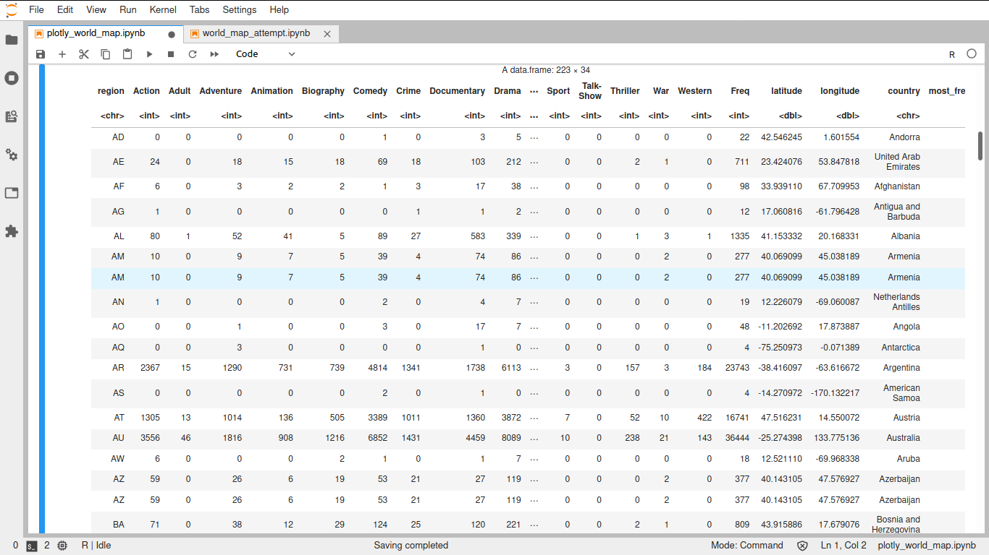
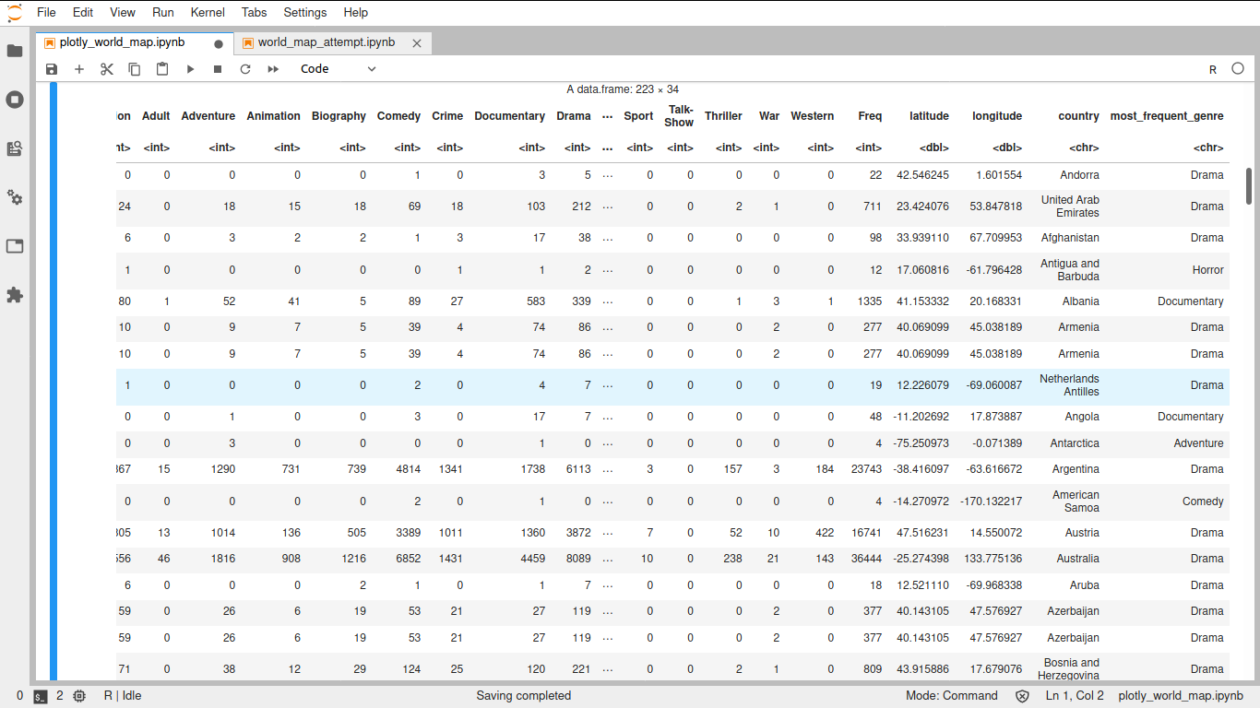
Titles per Region
Title Akas
↓8%
Title Akas Clean
Regions Frequency
Removal of
non-country regions
Transform
MERGE
Using an extra dataset...
Countries
country_code
latitude
longitude
country
usa_state_code
usa_state_longitude
usa_state_latitude
usa_state

Slide 13
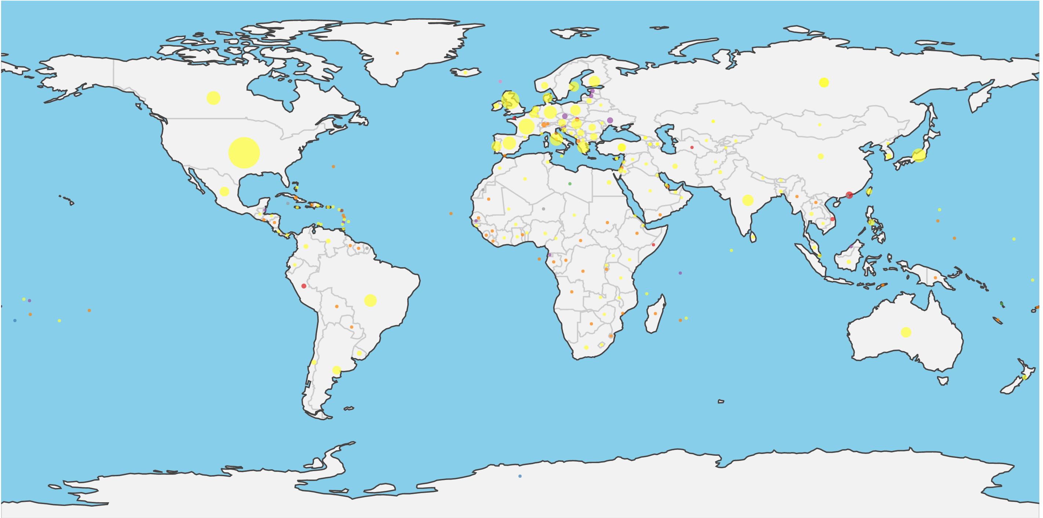





https://github.com/fsbarros98/IMDb_analysis/blob/main/graphic_results/regions_images/worldmap.html

Slide 14
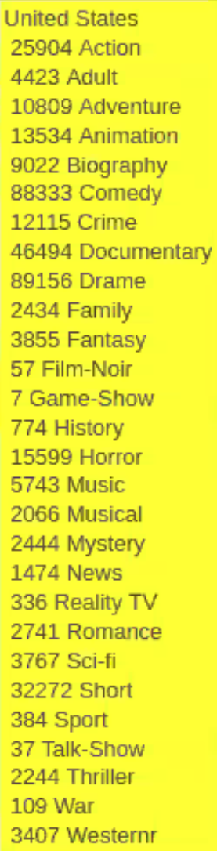
https://github.com/fsbarros98/IMDb_analysis/blob/main/graphic_results/regions_images/worldmap.html

Slide 15
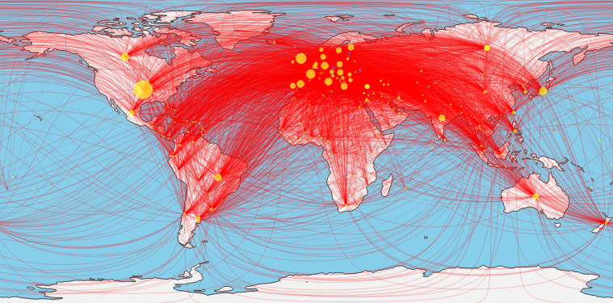
Titles per Region
Links between the regions
European continent has a lot of connections with the remaining countries
titles that are translated to more than one region are typically translated to some European country
https://github.com/fsbarros98/IMDb_analysis/blob/main/graphic_results/regions_images/worldmap.html

Slide 16
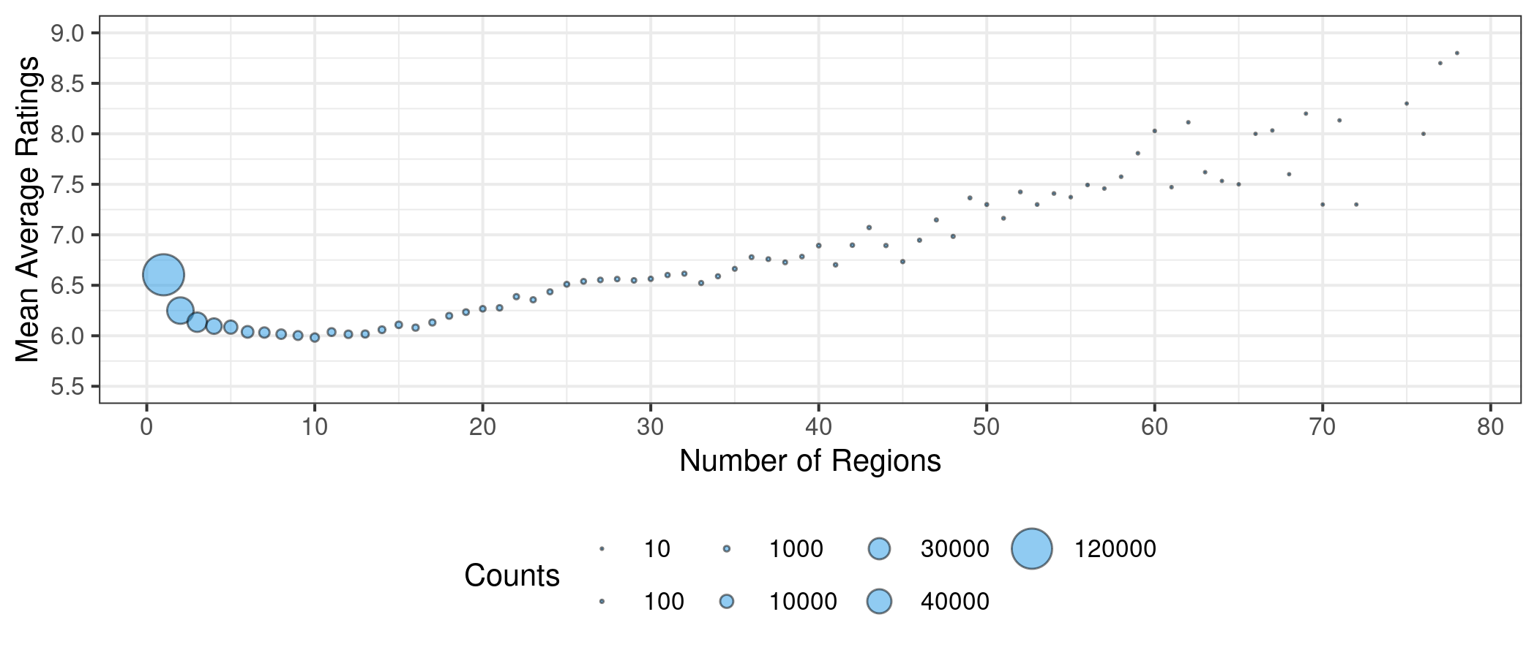
Titles per Region
Number of Regions vs. Mean Average Ratings
area of the circles represents the number of titles that were translated to a certain number of region

Slide 17
Titles per Region
Number of regions
Number of Regions vs. Mean Average Ratings
Counts
Mean Average Ratings
area of the circles represents the number of titles that were translated to a certain number of region

Slide 18
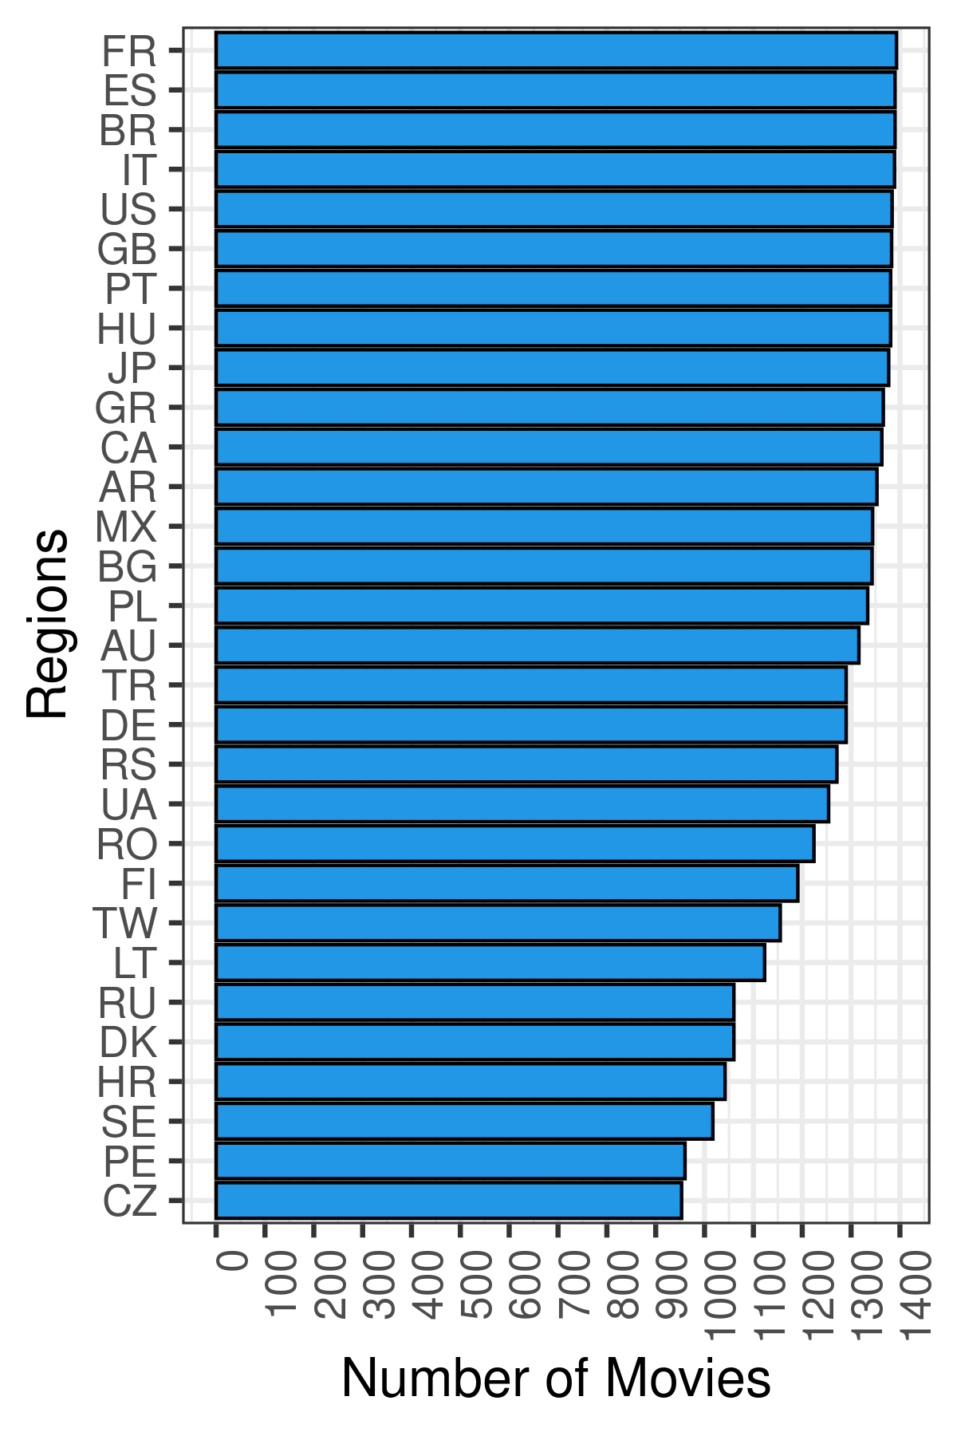

Titles per Region
Number of Regions vs. Mean Average Ratings
$$≥40 Regions$$

Slide 19
Titles per Region
Number of Regions vs. Mean Average Ratings
$$≥40 Regions$$
Most of these countries are European

Slide 20
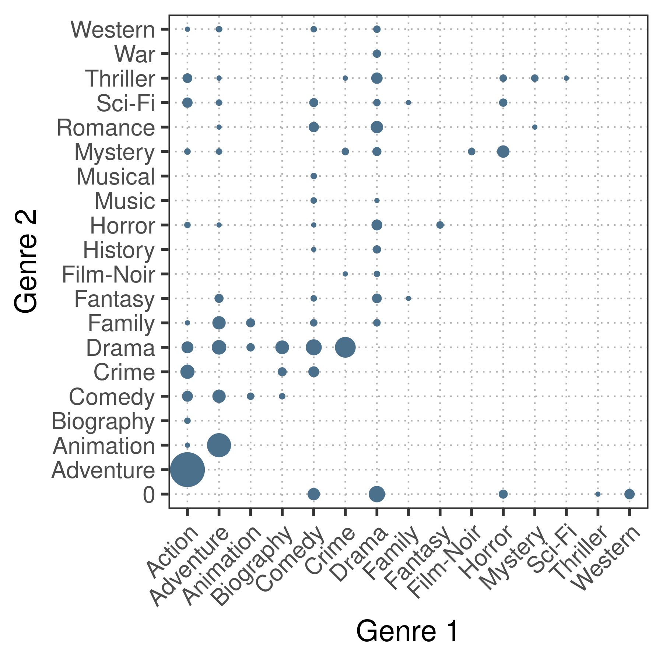

Movies with 2 genres
Titles per Region
Number of Regions vs. Mean Average Ratings
$$≥7 Mean Average Ratings$$

Slide 21



Movies with 2 genres
Titles per Region
Number of Regions vs. Mean Average Ratings
$$≥7 Mean Average Ratings$$
Action and Adventure are the most popular genres of these titles

Slide 22
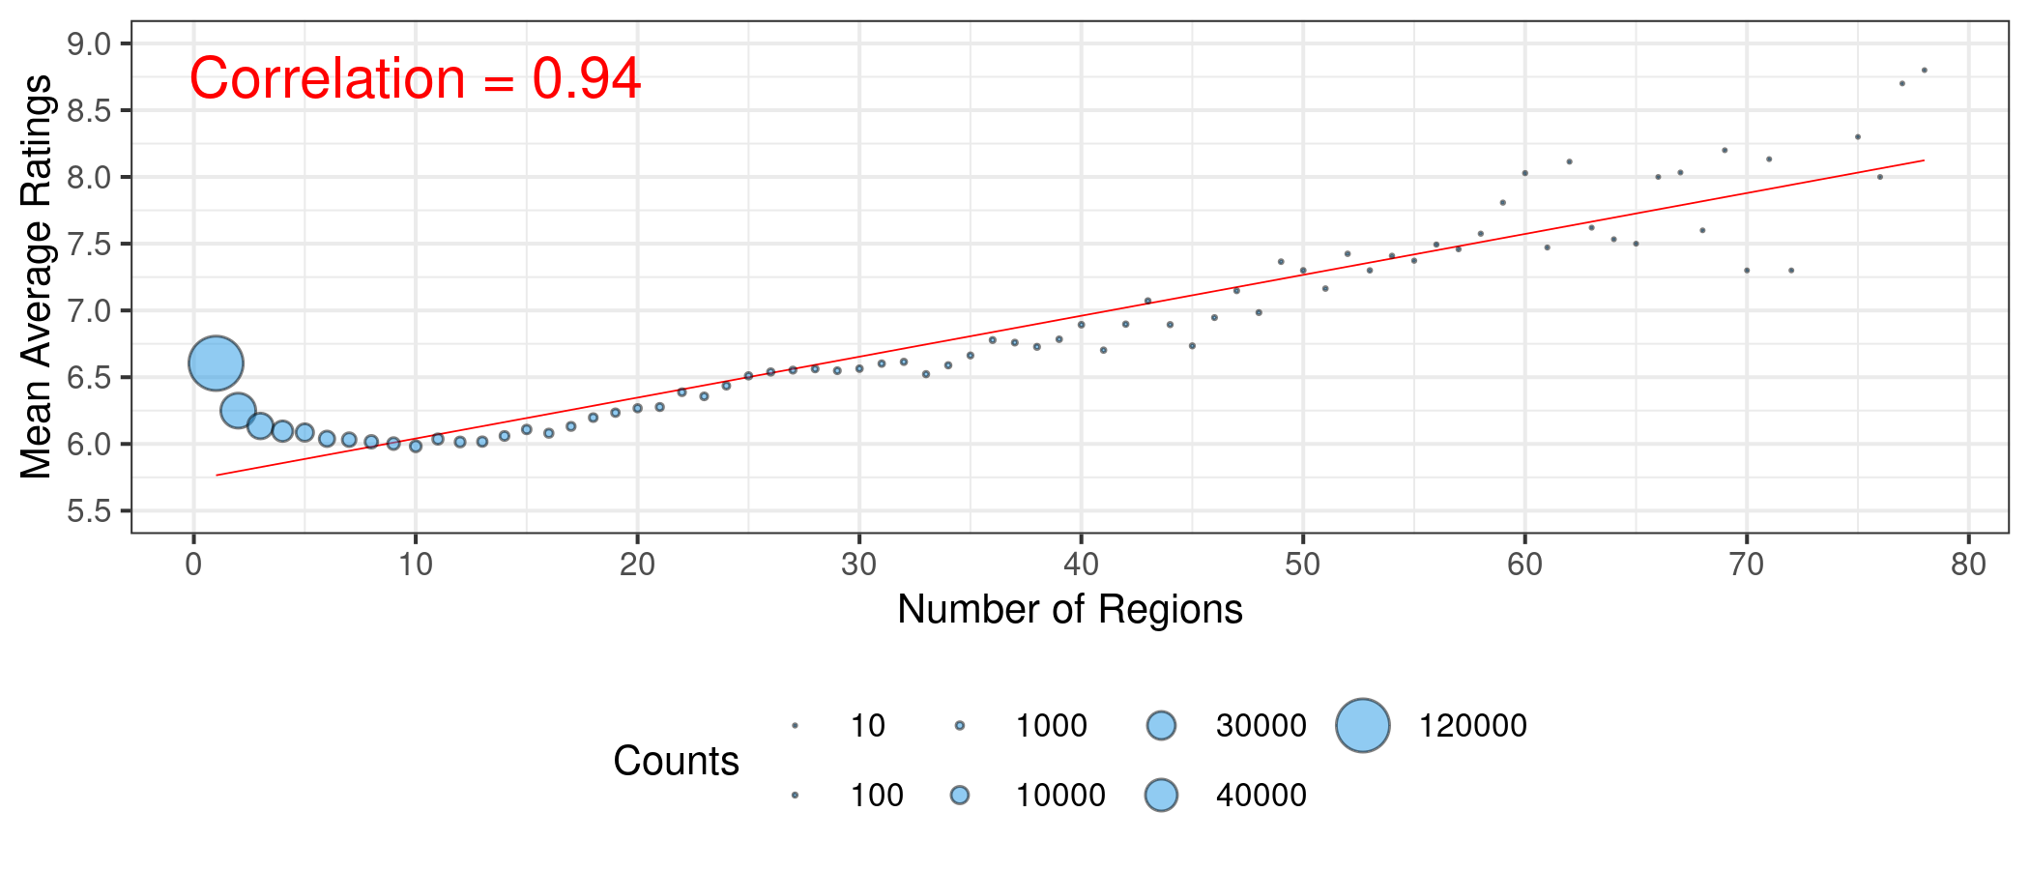
Titles per Region
Number of Regions vs. Mean Average Ratings
The success of a movie is higher when translated to other languages

Slide 23
Proposed Hypotheses
Titles per Region
Titles’ Success
Cast and Crew Influence
Title’s Awards
“Is the title’s success influenced by the number of translations?”
“Does the cast/crew of a movie make it successful?”

Slide 24
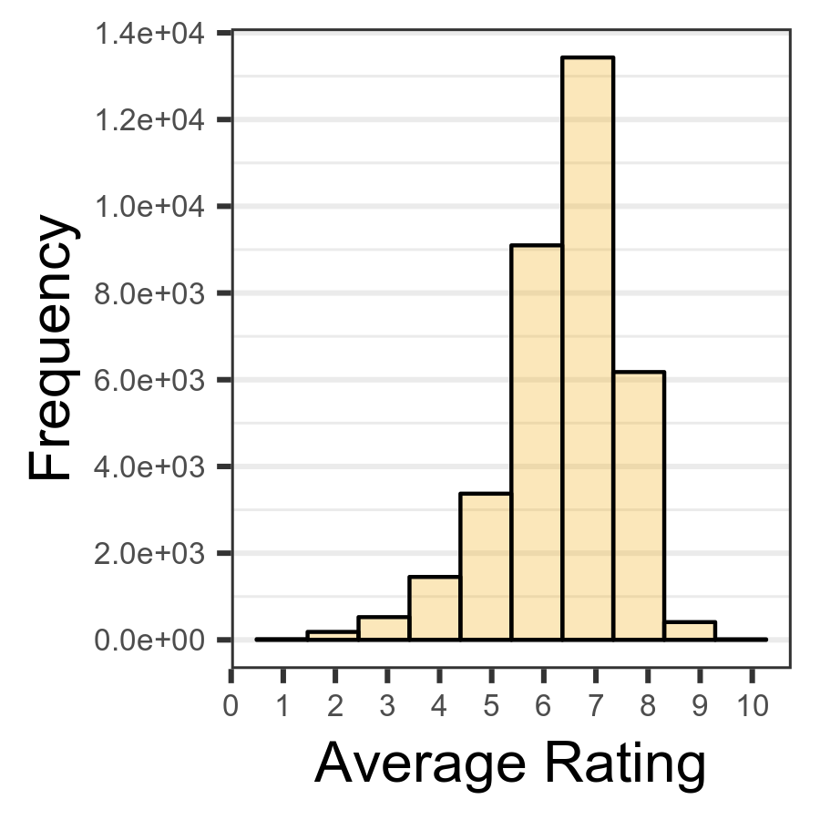
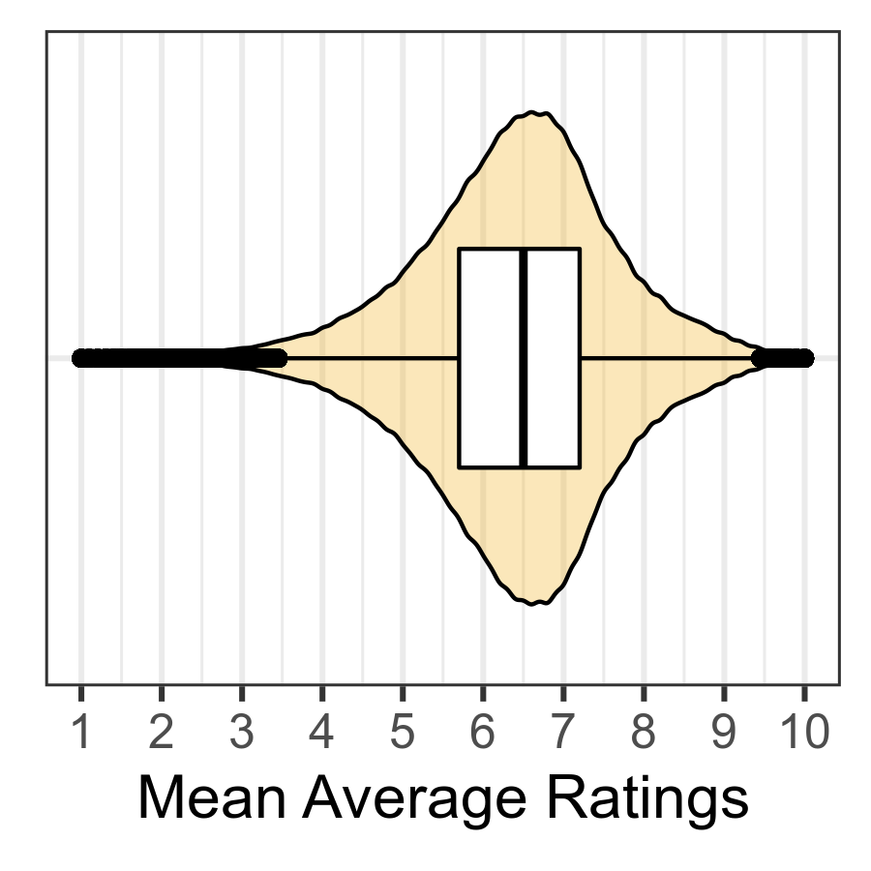
From dataset: Title Ratings
↓
Average Rating Histogram
From dataset: Title Ratings & Name Basics
↓
Violin & Box Plot
Titles’ Success
Cast and Crew Influence
Most ratings are considered average

Slide 25
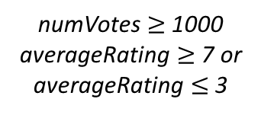
Merged Basics Ratings Crew Transformed
Merged Basics Ratings Crew
Titles’ Success
numVotes $≥$ 1000
averageRating $≥$ 7 or averageRating $≤$ 3
Cast and Crew Influence

Slide 26

Merged Basics Ratings Crew Transformed
Merged Basics Ratings Crew
Titles’ Success
numVotes $≥$ 1000
averageRating $≥$ 7 or averageRating $≤$ 3
Cast and Crew Influence
Name Basics
Name Basics filtered
Filter profession by
Actors/Actresses
Directors
Writers
People being known for a single movie goes from 1 to 3087

Slide 27
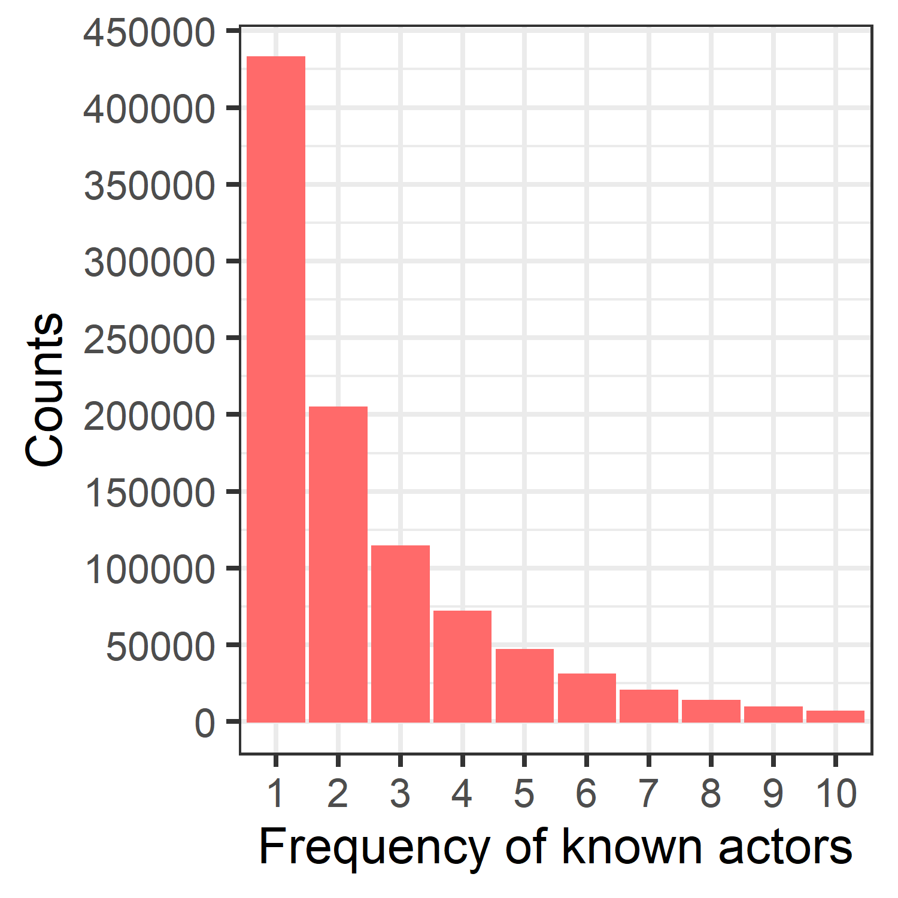
Merged Basics Ratings Crew Transformed
Merged Basics Ratings Crew
Titles’ Success
numVotes $≥$ 1000
averageRating $≥$ 7 or averageRating $≤$ 3
Cast and Crew Influence
Name Basics
Name Basics filtered
Filter profession by
Filter data by
Actors/Actresses
Directors
Writers
Keep only the titles with a maximum of 10 people they’re known for
Top 10 frequencies of the original one, that goes up to 3087 people known for a movie.
People being known for a single movie goes from 1 to 3087

Slide 28
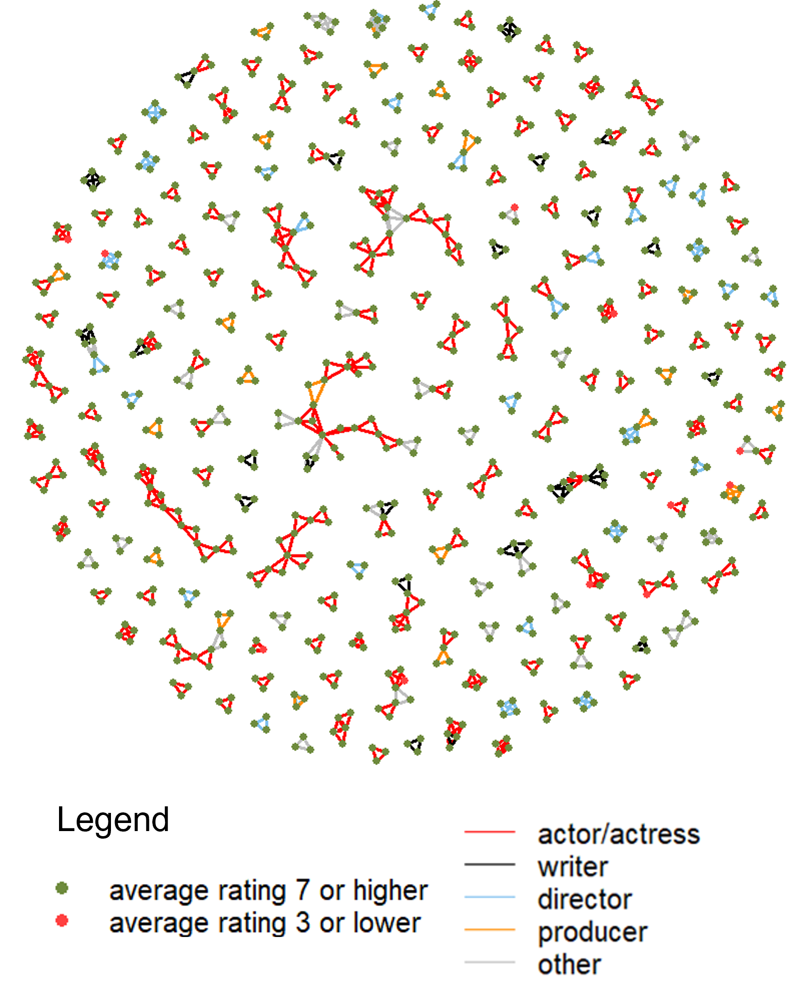
Titles’ Success
Cast and Crew Influence
features of this graph
each node is a movie and each link is a casting person in common
red nodes represent unsuccessful titles
green nodes represent successful titles
links are colored based on the primary profession of each person
a person has to be known for 3 or 4 titles

Slide 29
only 11 unsuccessful titles against 753 successful ones
Titles’ Success
Cast and Crew Influence
unsuccessful titles are present in small size chains
features of this graph
each node is a movie and each link is a casting person in common
successful titles are present in all sizes of chains
red nodes represent unsuccessful titles
green nodes represent successful titles
links are colored based on the primary profession of each person
successful movie tends to have more common people with other successful titles, than with unsuccessful ones
a person has to be known for 3 or 4 titles

Slide 30
Titles’ Success
clear majority of actors and actresses
Cast and Crew Influence
features of this graph
bigger and medium chains are dominated by actors/actresses
each node is a movie and each link is a casting person in common
red nodes represent unsuccessful titles
most relevant profession in these successful titles is the actor/actress
green nodes represent successful titles
links are colored based on the primary profession of each person
a person has to be known for 3 or 4 titles

Slide 31
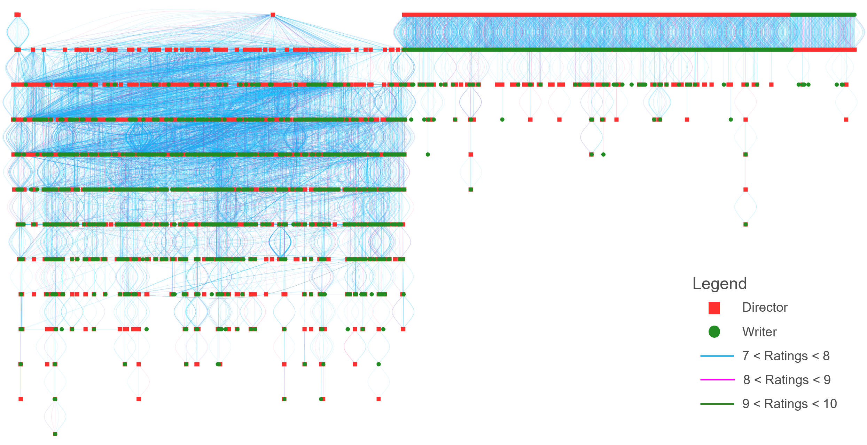
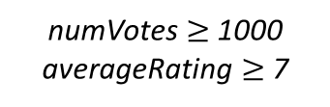
each node is a director or writer
Title Crew
Filtered Merged Title Crew and Ratings
numVotes $≥$ 1000
averageRating $≥$ 7
Titles’ Success
each link is a title separated by rating in color
Title Ratings
not display isolates and only display connected elements
Cast and Crew Influence

Slide 32
each node is a director or writer
Title Crew
Filtered Merged Title Crew and Ratings
numVotes $≥$ 1000
averageRating $≥$ 7
Titles’ Success
each link is a title separated by rating in color
Title Ratings
not display isolates and only display connected elements
Cast and Crew Influence
clear division amongst the data

Slide 33
each node is a director or writer
Title Crew
Filtered Merged Title Crew and Ratings
numVotes $≥$ 1000
averageRating $≥$ 7
Titles’ Success
each link is a title separated by rating in color
Title Ratings
not display isolates and only display connected elements
Cast and Crew Influence
clear division amongst the data
On the left, the directors relate themselves through some titles, and then these also relate to some writers

Slide 34
each node is a director or writer
Title Crew
Filtered Merged Title Crew and Ratings
numVotes $≥$ 1000
averageRating $≥$ 7
Titles’ Success
each link is a title separated by rating in color
Title Ratings
not display isolates and only display connected elements
Cast and Crew Influence
clear division amongst the data
On the right, a significant part of the directors only relate themselves to one writer

Slide 35
each node is a director or writer
Title Crew
Filtered Merged Title Crew and Ratings
numVotes $≥$ 1000
averageRating $≥$ 7
Titles’ Success
each link is a title separated by rating in color
Title Ratings
not display isolates and only display connected elements
Cast and Crew Influence
clear division amongst the data
no specific kin between the number of members of a crew and the title’s average rating above 7
one specific director is heavily related toother directors, so making a movie with this director may lead to success

Slide 36
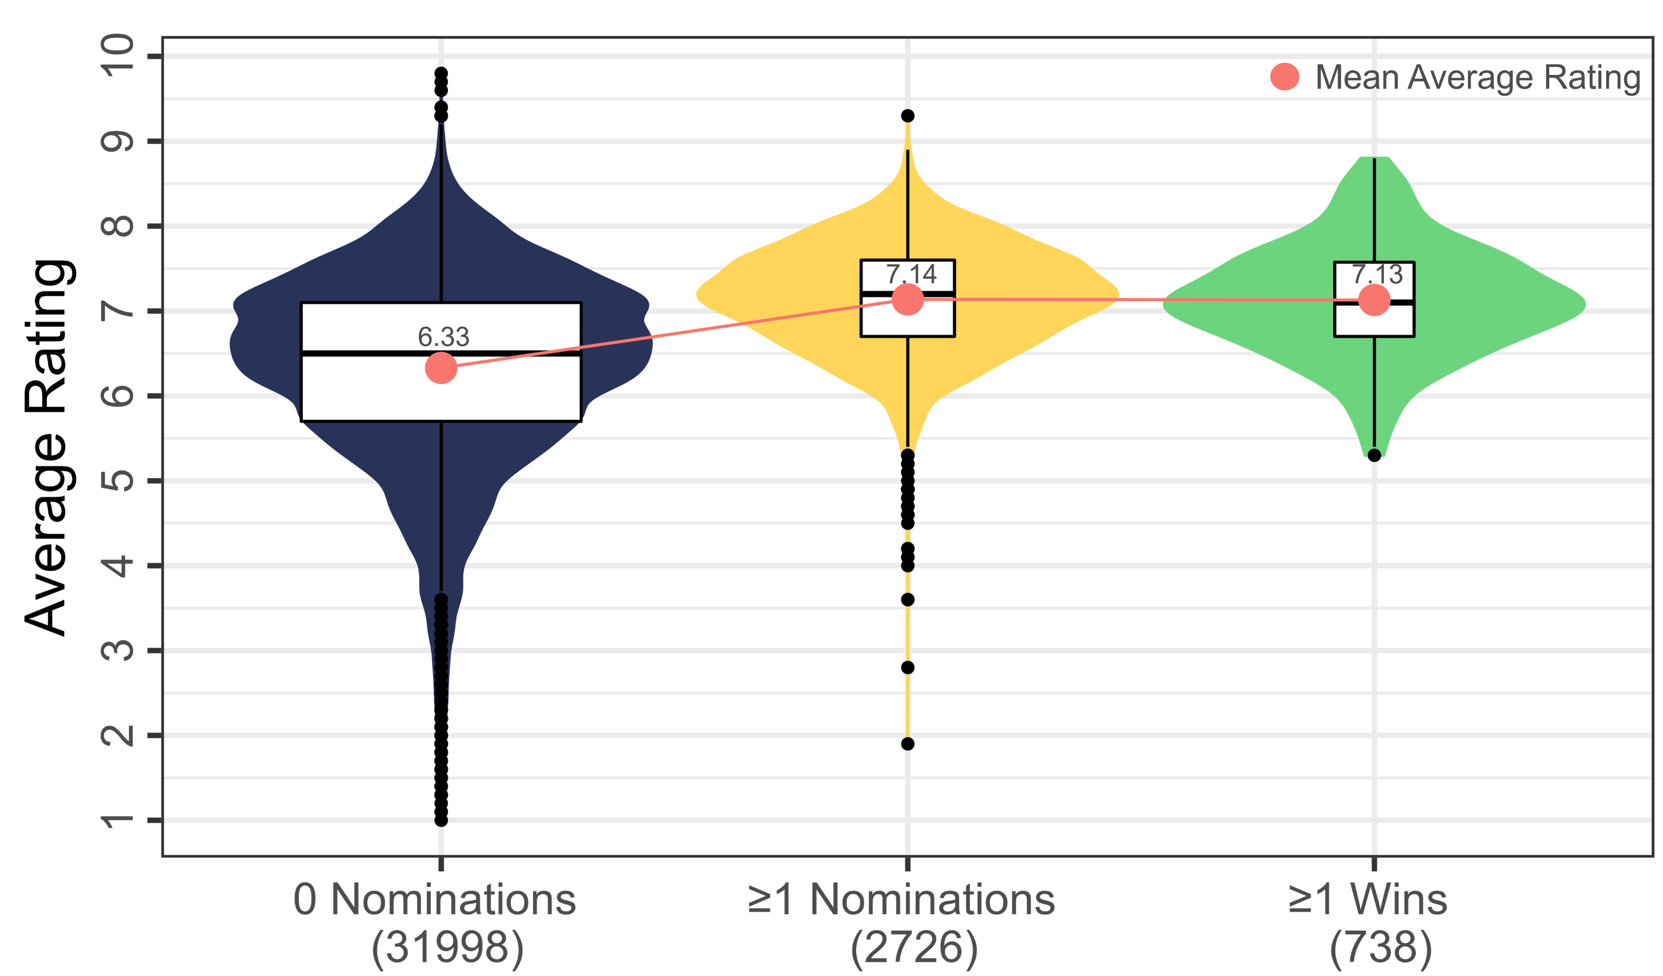
Using external data...
Emmy Awards
1649 matches
Titles’ Success
full join
Golden Globes
3808 matches
Title Basics
Title Ratings
Awards
727 for movies
3081 for people
Oscars Awards
8997 matches

Slide 37
Using external data...
Emmy Awards
1649 matches
Titles’ Success
full join
Golden Globes
3808 matches
Title Basics
Title Ratings
Title’s Awards
727 for movies
3081 for people
Oscars Awards
8997 matches
titles with no nominations have a distribution with a wider range than those which had nominations
most titles with nominations and wins have their IMDb average ratings above 5
distribution of titles with nominations and with winnings is very similar

Slide 38
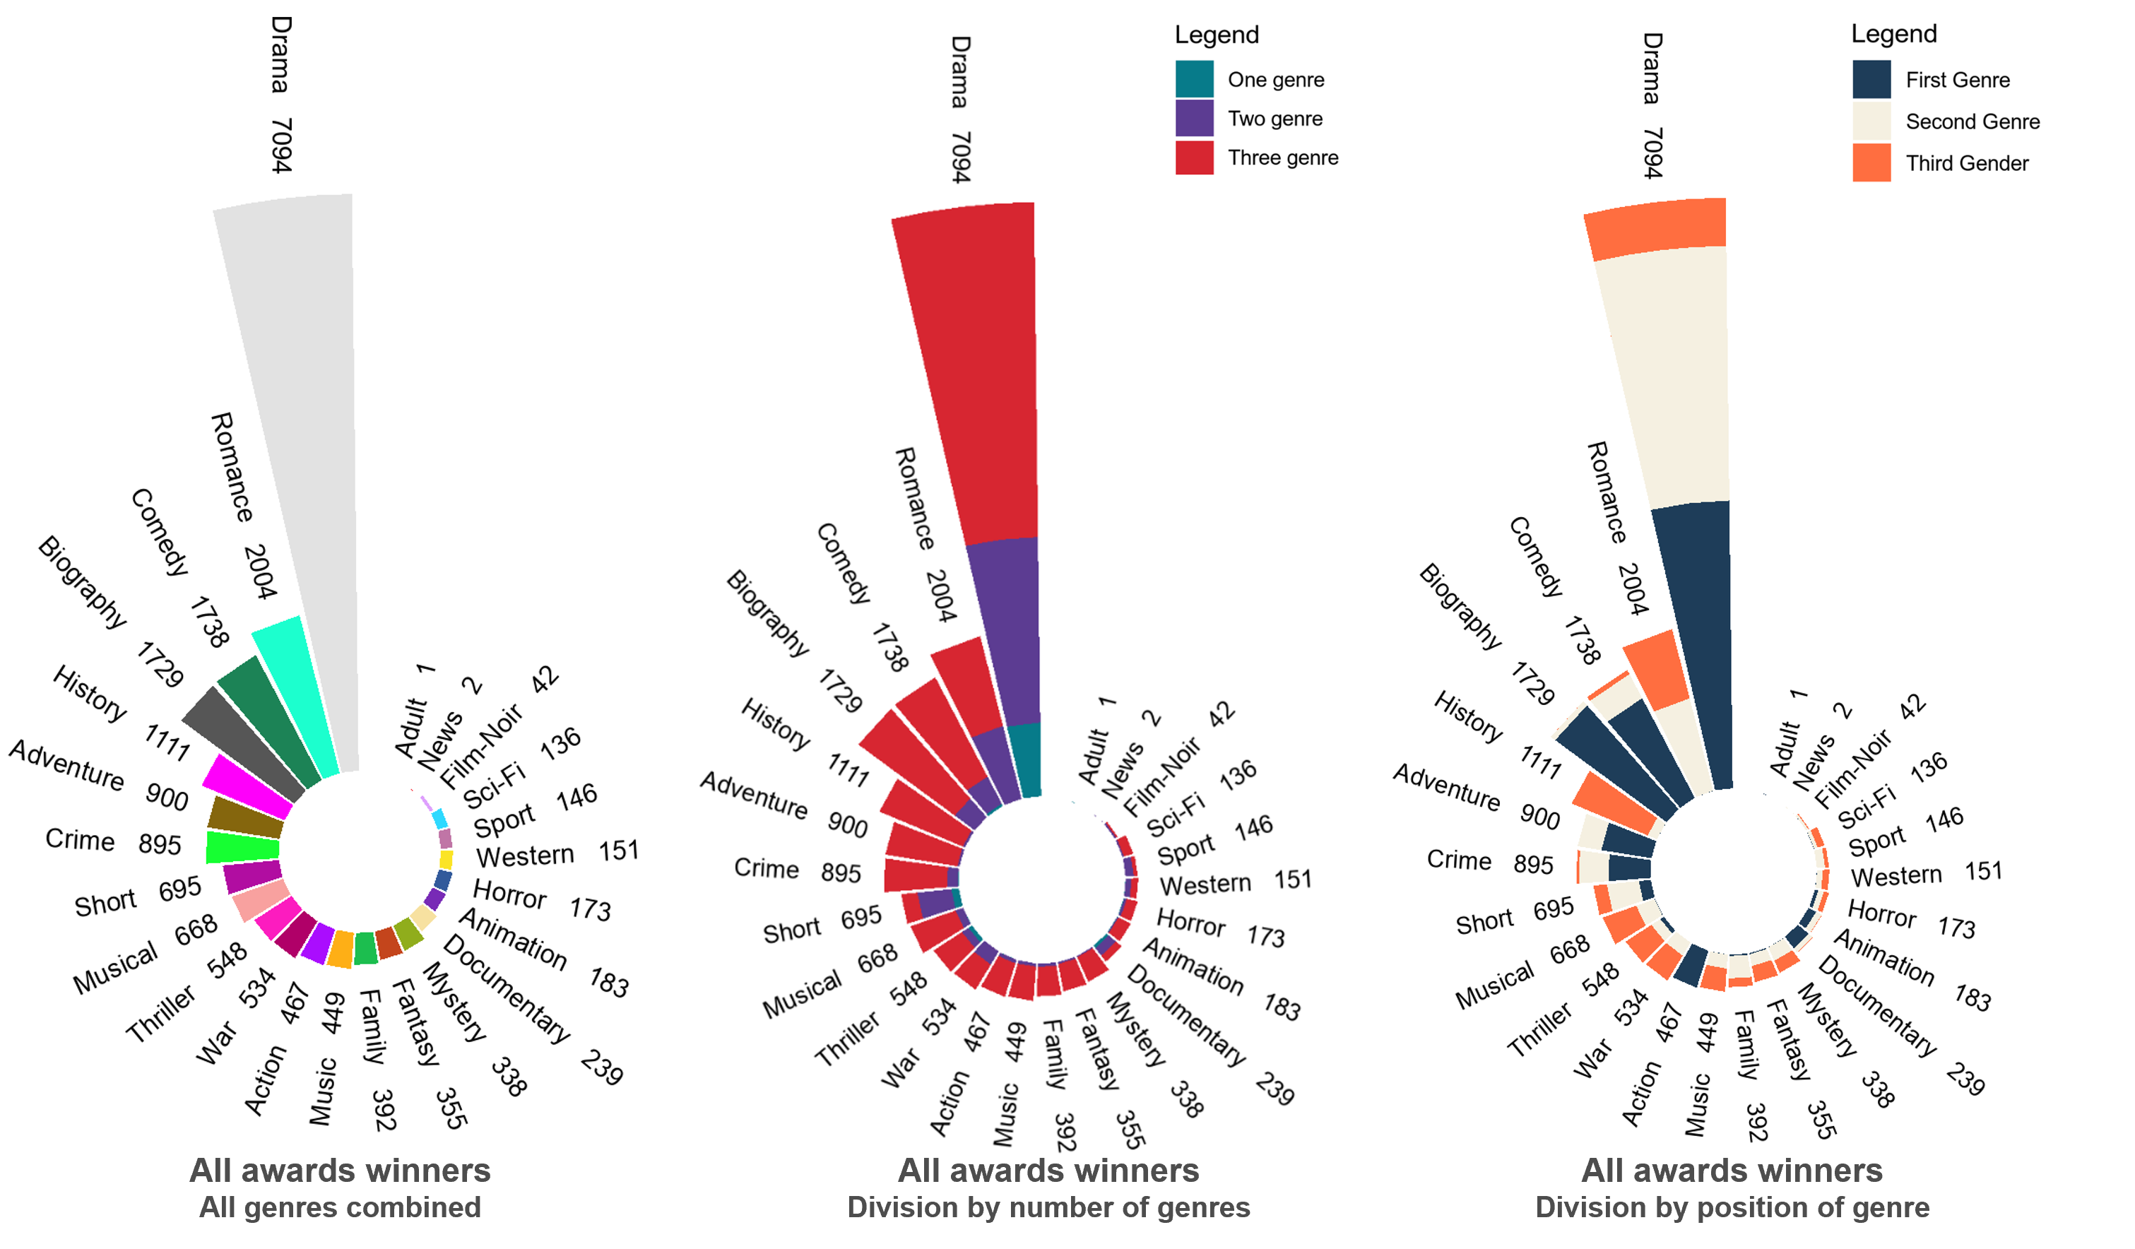
Titles’ Success
Considering only titles that actually won an award
Awards

Slide 39
Titles’ Success
Considering only titles that actually won an award
Awards
drama is the most popular genre for titles that won any type of award
most of the biography titles have this genre as their first genre
position of the genre is important for defining the type of the movie.

Slide 40
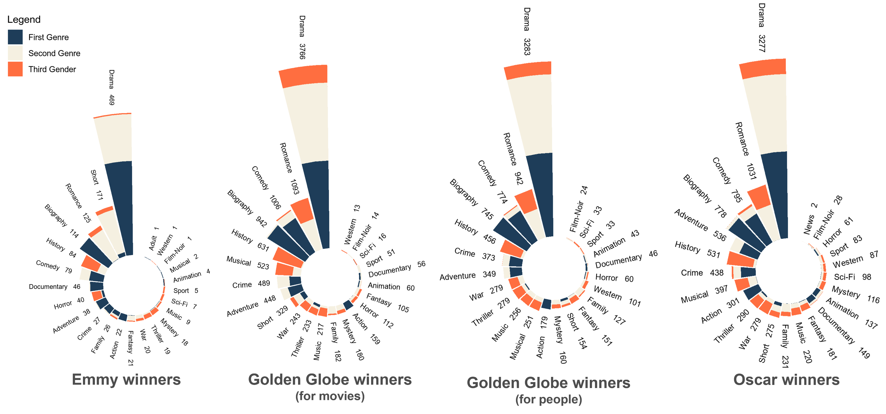
Titles’ Success
Considering only titles that actually won an award
Awards
not considering drama, a movie is more likely to get a Golden Globe for the people if it is a romance and for the movie, if it is a comedy

Slide 41
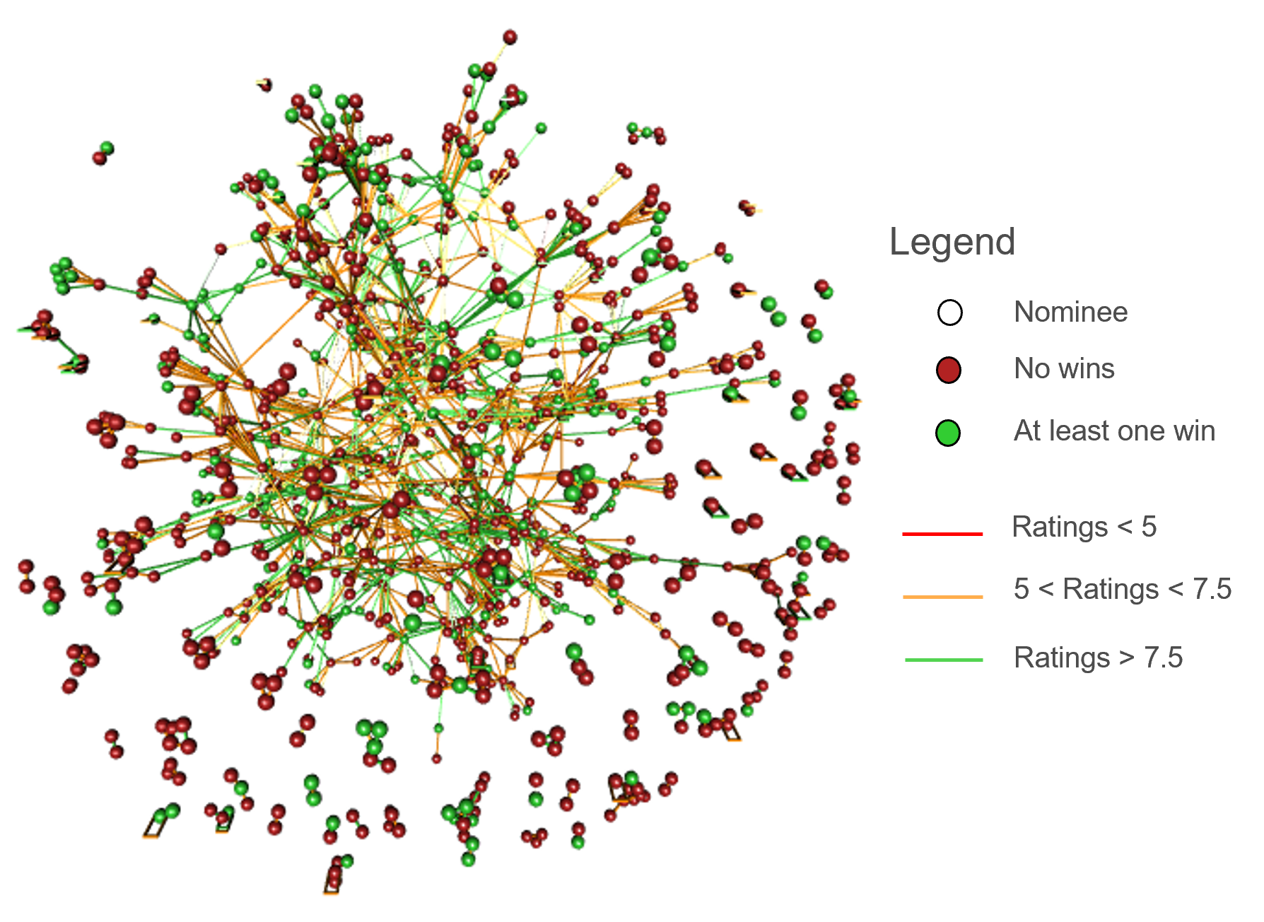
Titles’ Success
Awards
features of this graph
each node is a nominee, and each link is a movie in common
red nodes represent nominated people for the Golden Globes without wins
green nodes represent nominated people for the Golden Globes that won at least 1 award
links are colored based on the ratings of each title

Slide 42

Titles’ Success
Awards
nominees that did not win the award are more likely to be connected to other nominees that also did not win the award, regardless of the movie ratings
features of this graph
each node is a nominee, and each link is a movie in common
red nodes represent nominated people for the Golden Globes without wins
no relevant connection to the rating and the winning, all nominees have medium-high ratings
green nodes represent nominated people for the Golden Globes that won at least 1 award
links are colored based on the ratings of each title

Slide 43
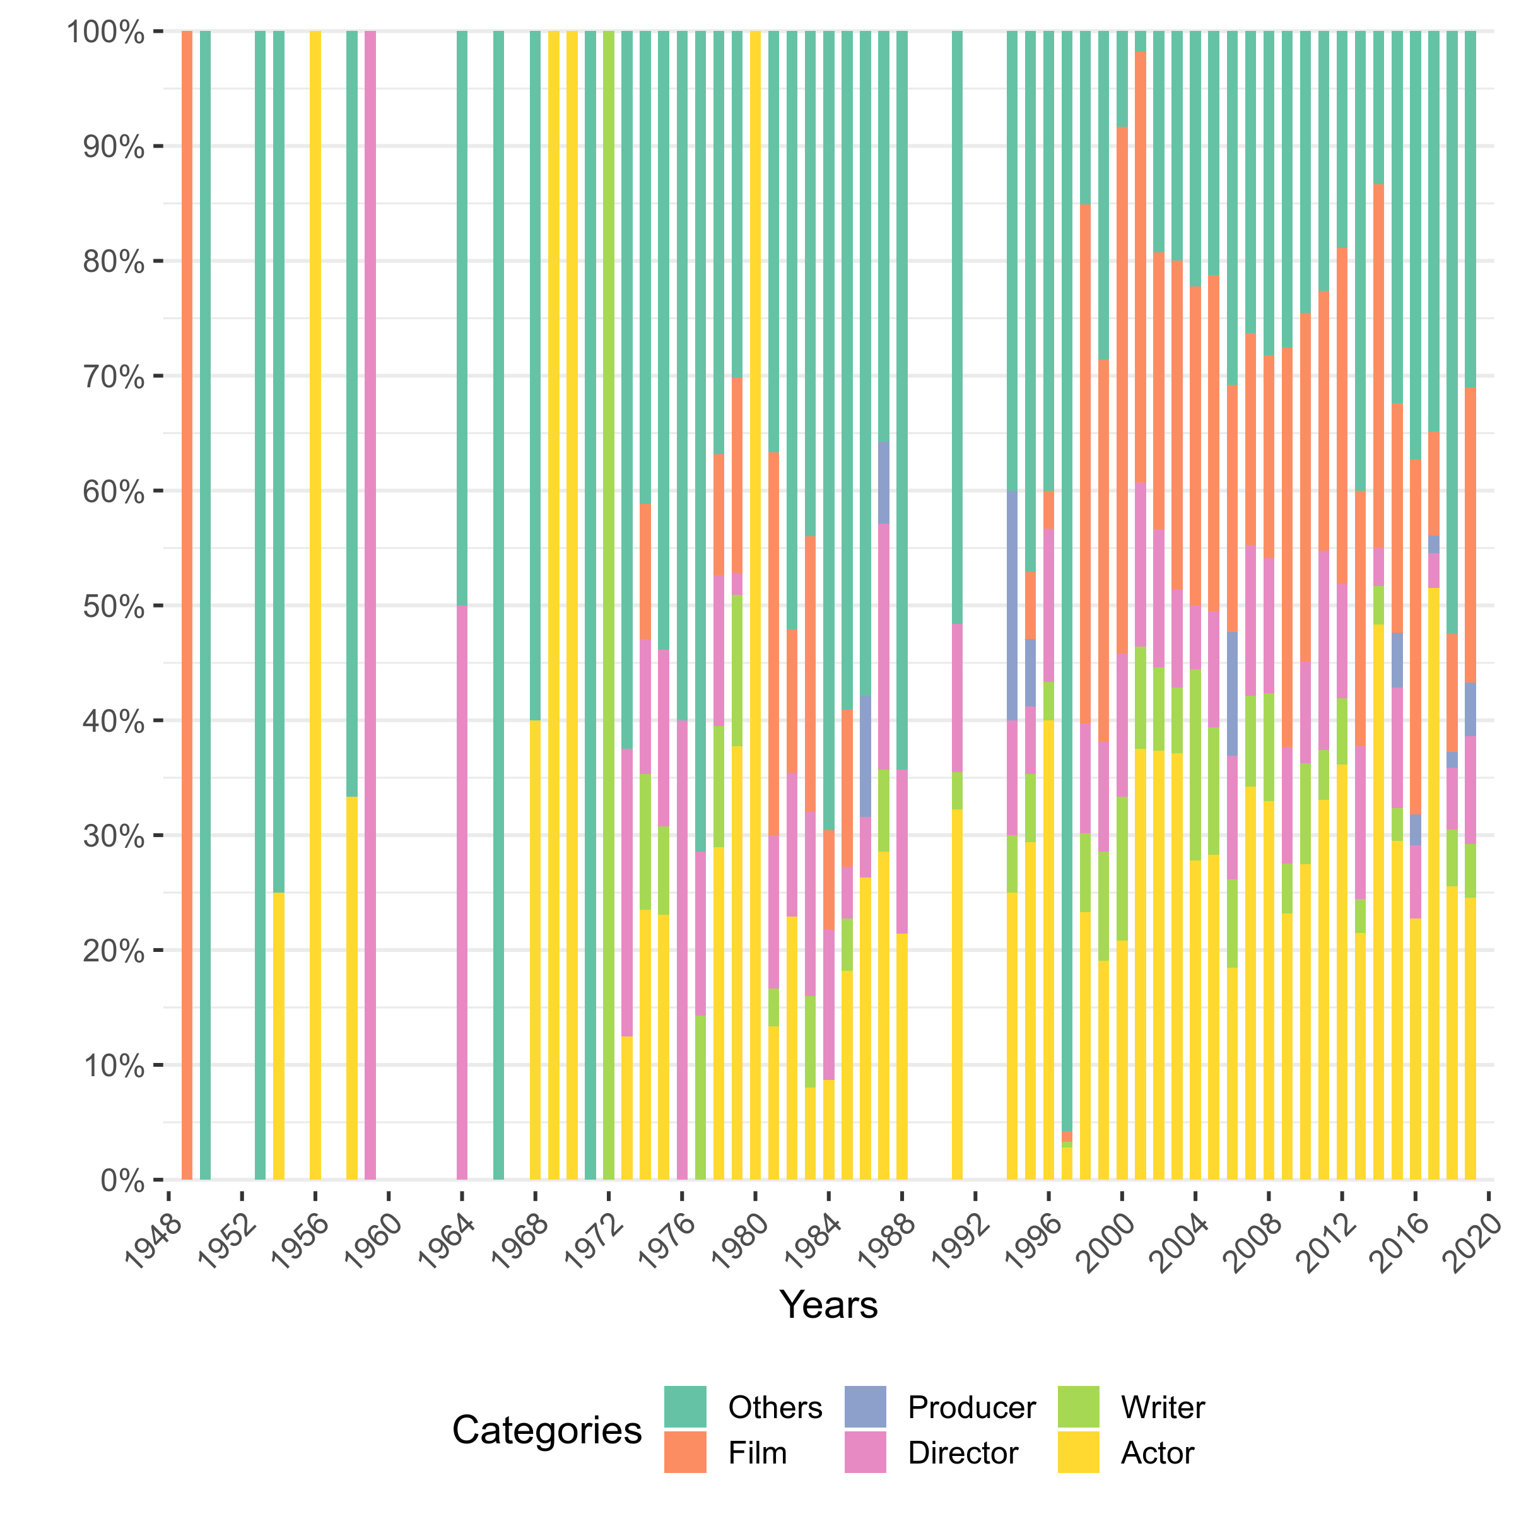
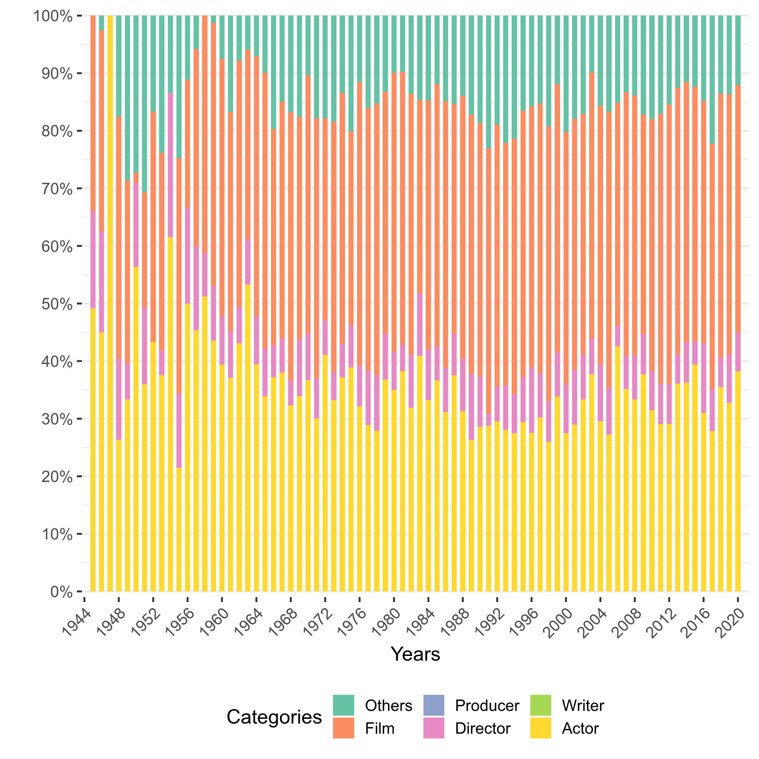
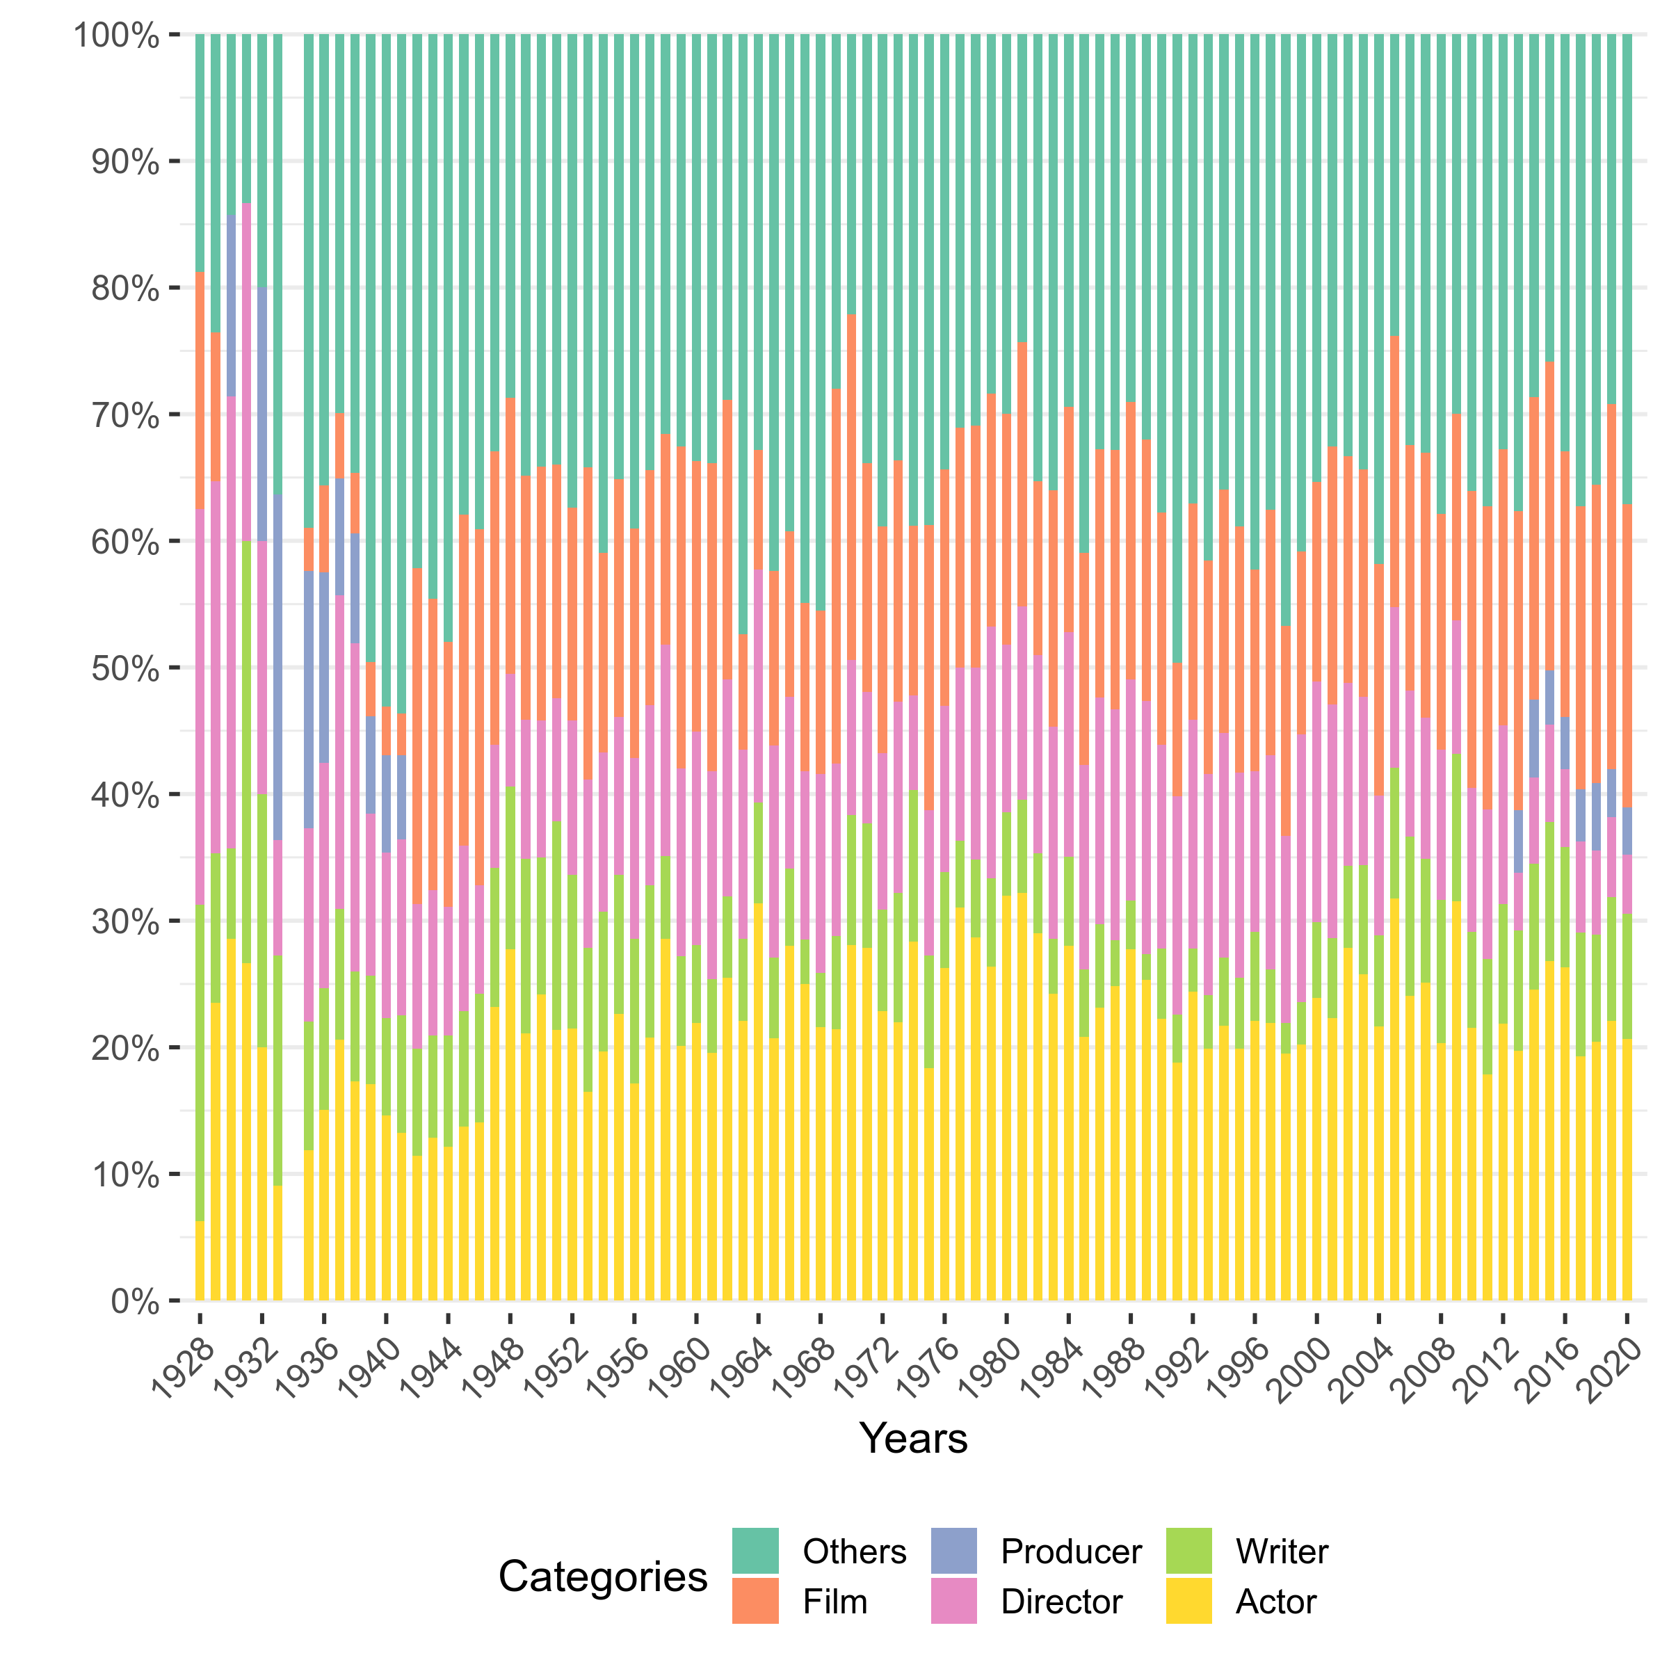
Categories of the awards
Corresponding data
Titles’ Success
Awards
Emmys Awards
Golden Globes
Oscars Awards

Slide 44
Categories of the awards
Corresponding data
Titles’ Success
Awards
very few producer dedicated awards
Golden Globes dedicates most awards to actors and film
Oscars have more well distributed categories than others
Emmys Awards
Golden Globes
Oscars Awards

Slide 45
Main Conclusions
US is the country to which most titles are translated.
Titles that are translated to more than one region are typically translated to a European country
As the number of regions increases, the average ratings get higher and the frequency of translated titles diminishes.
Actors are the most relevant people for characterizing the title’s success, that is, the average ratings.
Despite this, there may be some specific members of the crew, more exactly directors, that can be related to a title’s success.
Titles that win any type of the awards explored have higher ratings.

Slide 46

Any questions?
IMDb
Datasets Analysis

